Slide 1
Projet fin de formation développement Web FullStack JS
Planning Autorisation

Slide 2
Conception
User Story
Diagramme de classe
Diagramme de cas d’utilisation

Slide 3
User Story
As a user I need to:
Create accomunt
Update his information
Demand An autorisation
Update Date autorisation
send mail for autorisation

Slide 4
AS a chef I need to :
consult demands of employees
accepted or reject the demand
Send Email to employee
As a User with role=Admin I need to :
Delete User

Slide 5
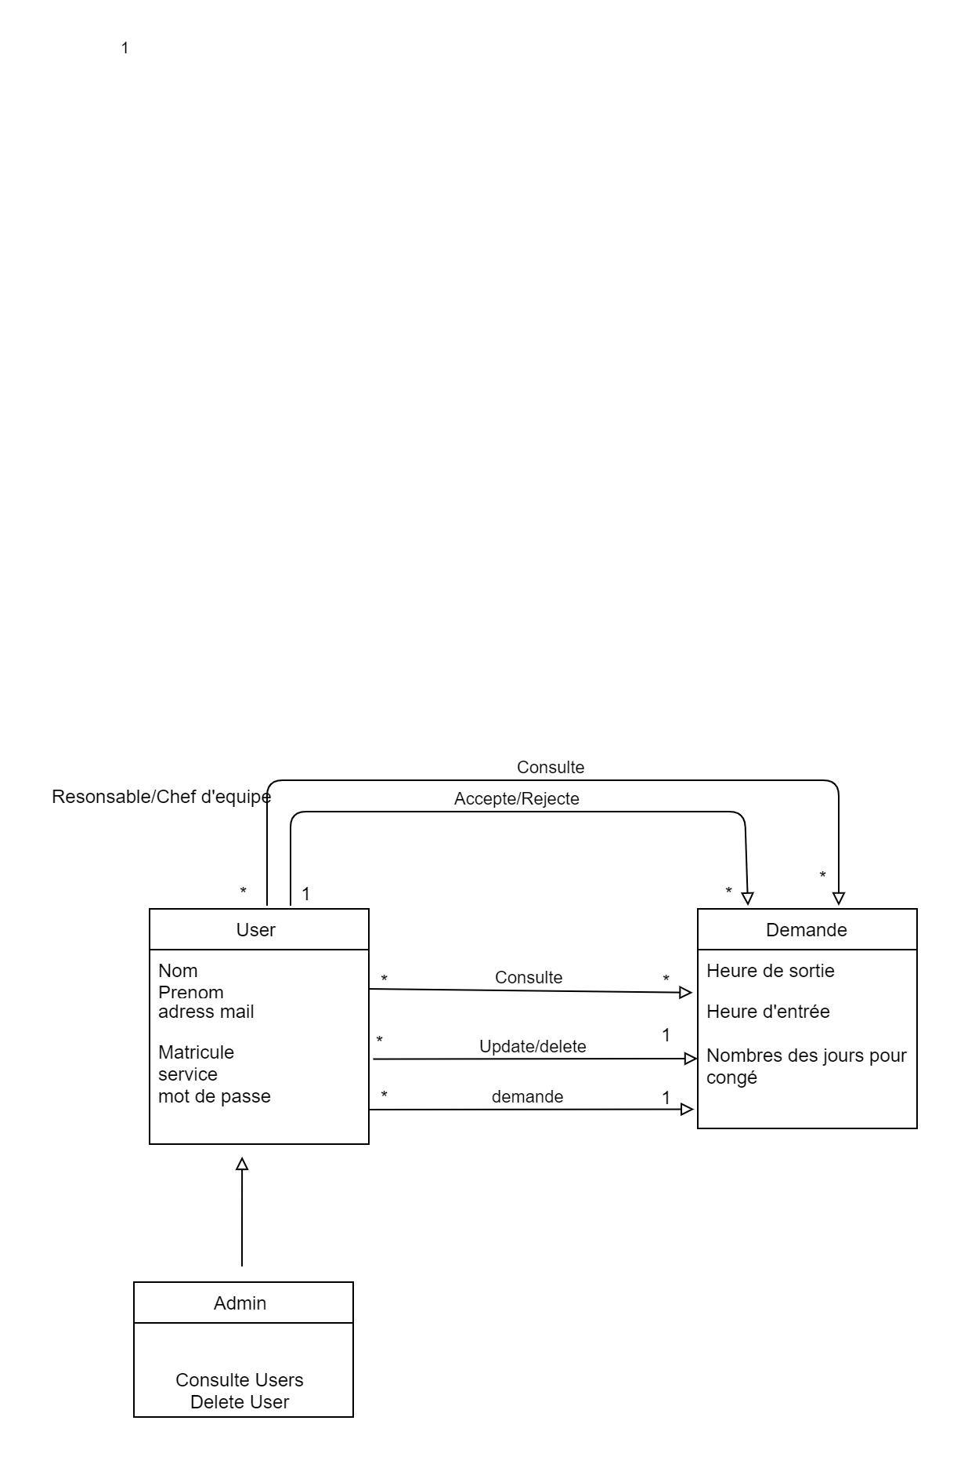
2. Diagramme de classe

Slide 6
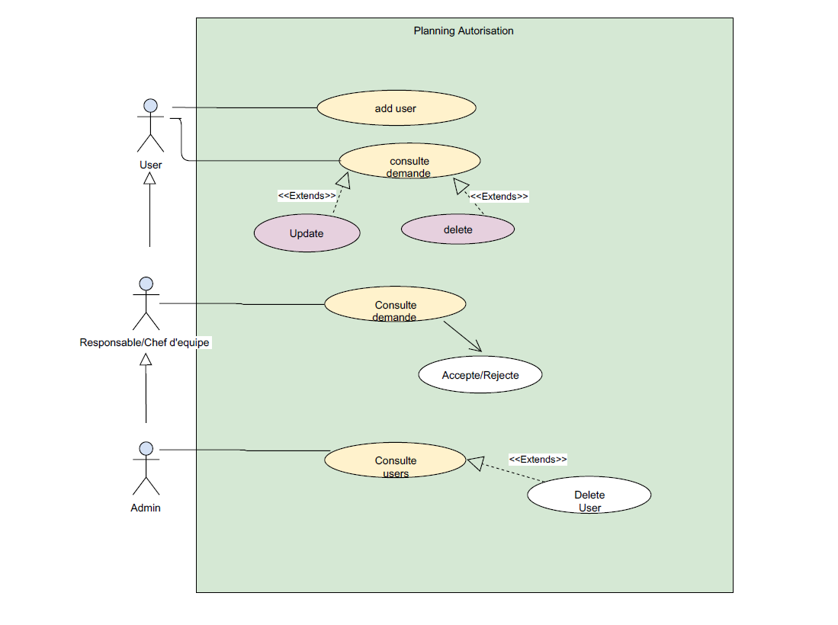
3. Diagramme de cas d’utilisation

Slide 7
Fin projet

